Slide 1


PROJECT WORK II Personal Blog Application
Anubhav Hardia
CSE-VIII-A
Linkites Infotech PVT Limited

Slide 2
Personal Blog Application
Individual expression has evolved into a new and useful form. Blogs have become an important form of emotional and informational release for a growing proportion of the population. Commencing with an overview of the development of the blog, this paper takes the reader through a journey of understanding, explaining why blogs are important, how they work, who writes, and who reads them. Ultimately, the paper explains how blogs can be used for research, the opportunities of using blogs as research input, as well as the problems this usage involves.

Slide 3
WhaT Personal Blog App Do?
Users can share, update , edit their personal as well as professional Achievements, Memories ,Moments.
Application Provides Security With Usernames And Password
It is Robust And Secured Application Where Users Will Be able To Write Blog Posts and can Share It with Videos And Images

Slide 4


Technologies
JavaScript
Node JS
Express JS
MongoDB

Slide 5

Javascript
JavaScript is a scripting or programming language that allows you to implement complex features on web pages — every time a web page does more than just sit there and display static information for you to look at — displaying timely content updates, interactive maps, animated 2D/3D graphics, scrolling video jukeboxes, etc. — you can bet that JavaScript is probably involved. It is the third layer of the layer cake of standard web technologies, two of which (HTML and CSS) we have covered in much more detail in other parts of the Learning Area.

Slide 6

Node.js
Node.js is an open source, cross-platform runtime environment for developing server-side and networking applications. Node.js applications are written in JavaScript, and can be run within the Node.js runtime on OS X, Microsoft Windows, and Linux.
Node.js also provides a rich library of various JavaScript modules which simplifies the development of web applications using Node.js to a great extent.

Slide 7
Features of Node.js
Following are some of the important features that make Node.js the first choice of software architects.
Asynchronous and Event Driven − All APIs of Node.js library are asynchronous, that is, non-blocking. It essentially means a Node.js based server never waits for an API to return data. The server moves to the next API after calling it and a notification mechanism of Events of Node.js helps the server to get a response from the previous API call.
Very Fast − Being built on Google Chrome's V8 JavaScript Engine, Node.js library is very fast in code execution.
Single Threaded but Highly Scalable − Node.js uses a single threaded model with event looping. Event mechanism helps the server to respond in a non-blocking way and makes the server highly scalable as opposed to traditional servers which create limited threads to handle requests. Node.js uses a single threaded program and the same program can provide service to a much larger number of requests than traditional servers like Apache HTTP Server.
No Buffering − Node.js applications never buffer any data. These applications simply output the data in chunks.

Slide 8
Express
Express.js is a web application framework for Node.js. It provides various features that make web application development fast and easy which otherwise takes more time using only Node.js.
Express.js is based on the Node.js middleware module called connect which in turn uses http module. So, any middleware which is based on connect will also work with Express.js.

Slide 9
Advantages of Express.js
Makes Node.js web application development fast and easy.
Easy to configure and customize.
Allows you to define routes of your application based on HTTP methods and URLs.
Includes various middleware modules which you can use to perform additional tasks on request and response.
Easy to integrate with different template engines like Jade, Vash, EJS etc.
Allows you to define an error handling middleware.
Easy to serve static files and resources of your application.
Allows you to create REST API server.
Easy to connect with databases such as MongoDB, Redis, MySQL

Slide 10

MONGODB
MongoDB is an open source NoSQL database management program. NoSQL is used as an alternative to traditional relational databases. NoSQL databases are quite useful for working with large sets of distributed data. MongoDB is a tool that can manage document-oriented information, store or retrieve information.

Slide 11
MongoDB Features
Each database contains collections which in turn contains documents. Each document can be different with a varying number of fields. The size and content of each document can be different from each other.
The document structure is more in line with how developers construct their classes and objects in their respective programming languages. Developers will often say that their classes are not rows and columns but have a clear structure with key-value pairs.
The rows (or documents as called in MongoDB) doesn’t need to have a schema defined beforehand. Instead, the fields can be created on the fly.
The data model available within MongoDB allows you to represent hierarchical relationships, to store arrays, and other more complex structures more easily.
Scalability – The MongoDB environments are very scalable. Companies across the world have defined clusters with some of them running 100+ nodes with around millions of documents within the database

Slide 12
What's an API?
An API is a set of definitions and protocols for building and integrating application software. It’s sometimes referred to as a contract between an information provider and an information user—establishing the content required from the consumer (the call) and the content required by the producer (the response). For example, the API design for a weather service could specify that the user supply a zip code and that the producer reply with a 2-part answer, the first being the high temperature, and the second being the low.
In other words, if you want to interact with a computer or system to retrieve information or perform a function, an API helps you communicate what you want to that system so it can understand and fulfill the request.
REST is a set of architectural constraints, not a protocol or a standard. API developers can implement REST in a variety of ways.
When a client request is made via a RESTful API, it transfers a representation of the state of the resource to the requester or endpoint.

Slide 13
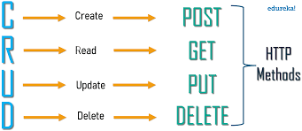
restful api methods

Slide 14


Slide 15


Slide 16
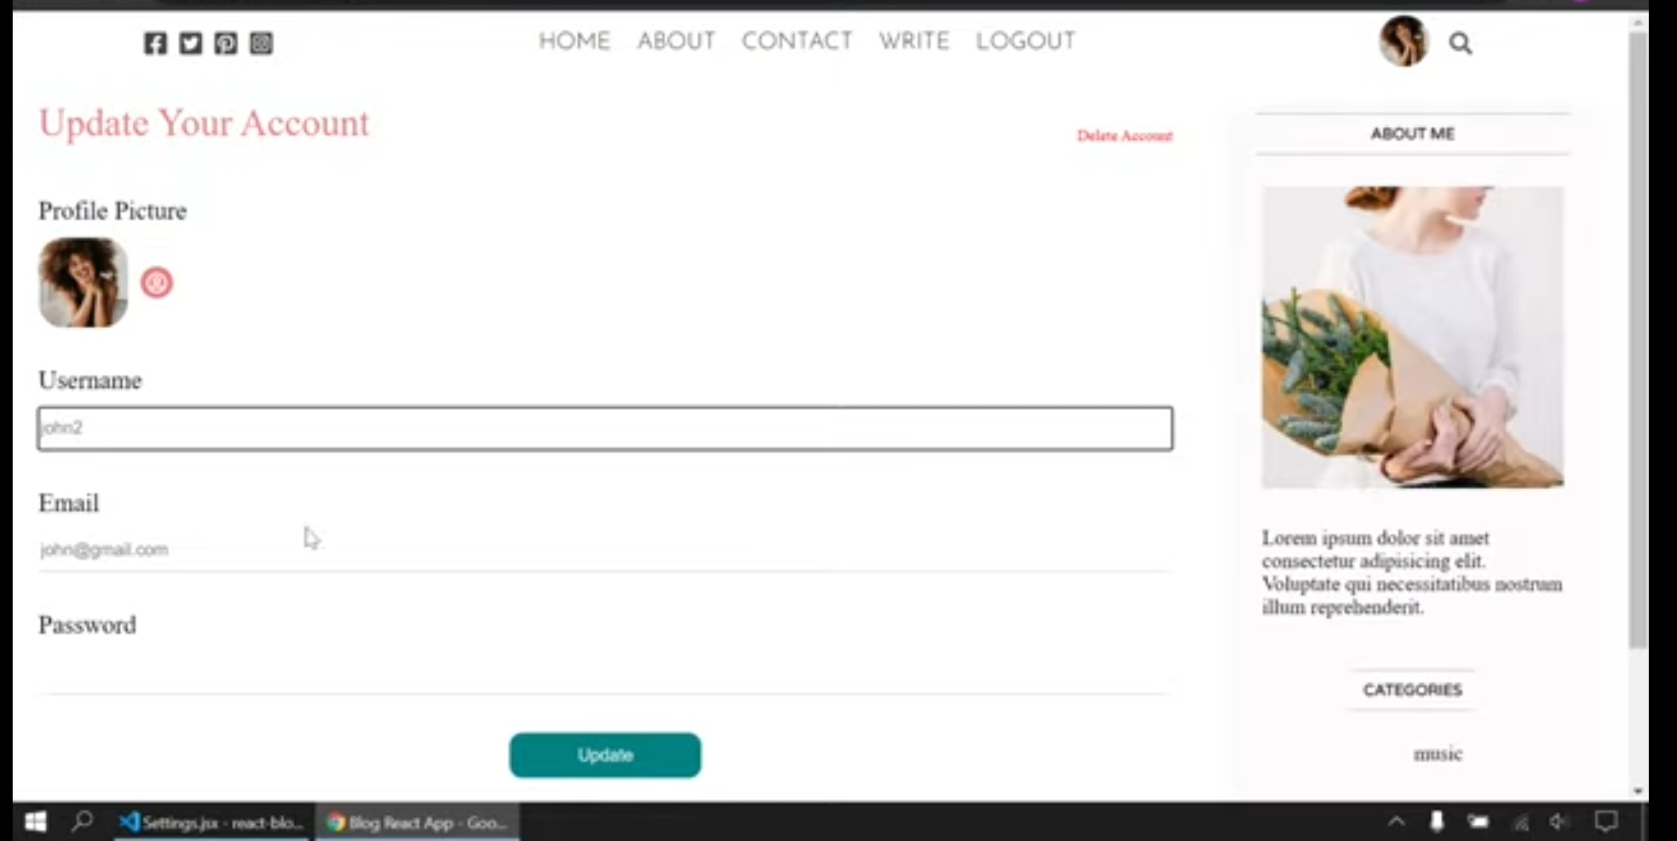

Slide 17


